Slide 1
DNA sequencing and applying
classifier with ML​

Slide 2
Introducation:-
In the field of medical information research, the genetic series is widely used as a component of a category. One of the applications of ML is biochemistry. Bioinformatics is an interdisciplinary science that uses computers and communication science to understand biological data. One of its most difficult tasks is to distinguish between regular genes and disease-causing genes.

Slide 3
The classification of gene sequences into existing categories is utilized in genomic research to discover the functions of novel proteins. As a result, it is critical to identify and categorize such genes. We employ ML approaches to distinguish between infected and normal genes using classification methods.

Slide 4
I will apply a classification model that can predict a gene's function based on the DNA sequence of the coding sequence alone.

Slide 5
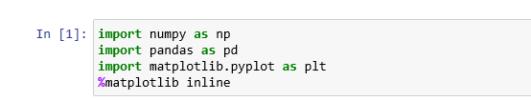
You will need some libraries such as: numpy, pandas ..

Slide 6
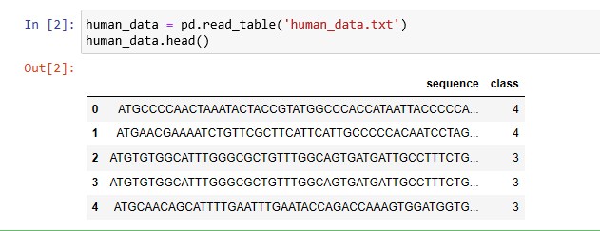
I will upload human data and read it
to became have some data for human
DNA sequence coding regions
and a class label.

Slide 7
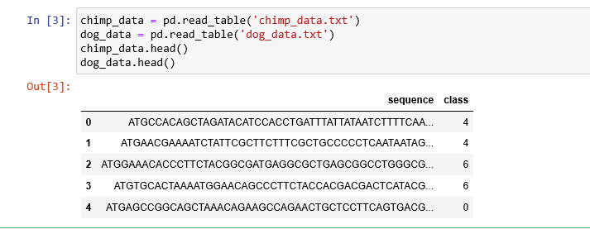
I also upload and read data for Chimpanzee and a more divergent species, the dog.

Slide 8
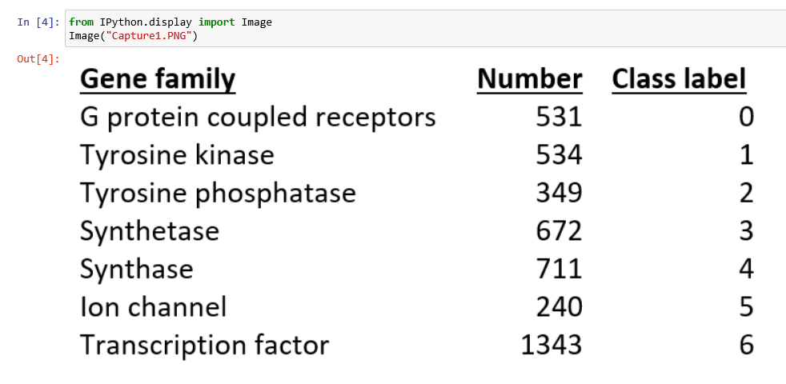
Here are the definitions for each of the 7 classes and how many there are in the human training data. They are gene sequence function groups.

Slide 9

Since seq is not equal, we will apply the k-mers to the complete sequences.
Using get Kmers function

Slide 10
Now, our coding sequence data is changed to lowercase, split up into all possible k-mer words of length 6

Slide 11
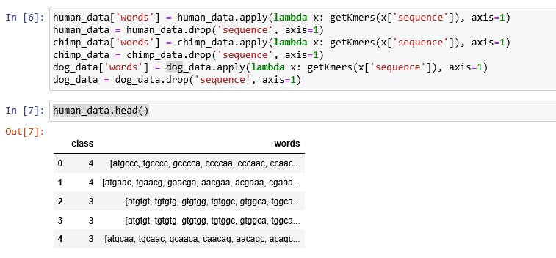

Slide 12
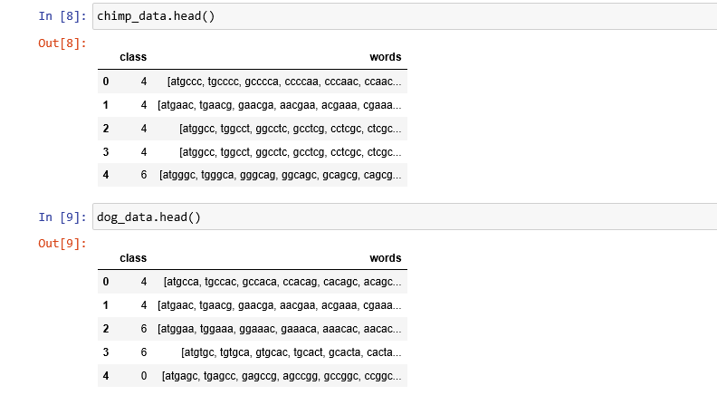

Slide 13
Since we are going to use scikit-learn natural language processing tools to do the k-mer counting, we need to now convert the lists of k-mers for each gene into string sentences of words that the count vectorizer can use.

Slide 14
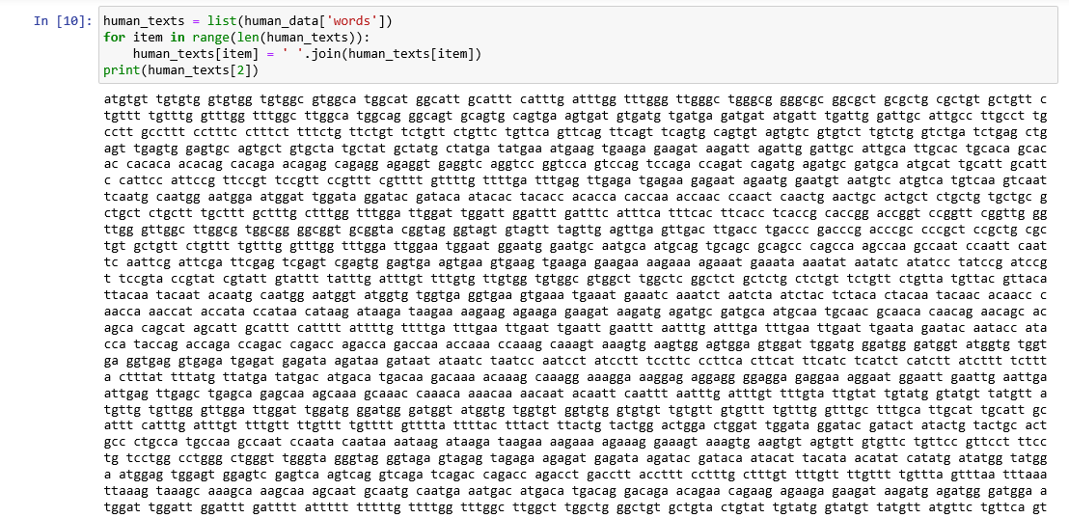

Slide 15
We can also make a y variable to hold the class labels.

Slide 16
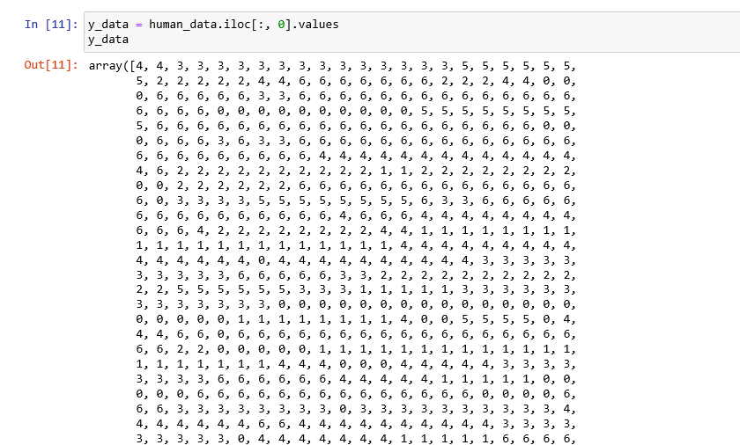

Slide 17
We will perform the same steps for chimpanzee and dog

Slide 18
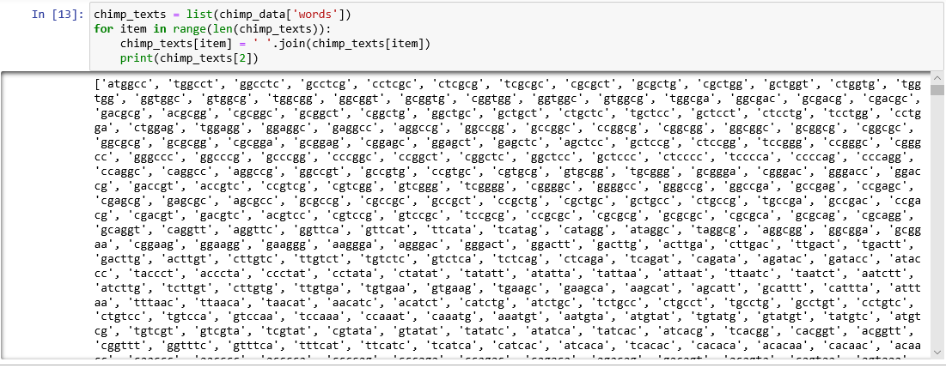

Slide 19
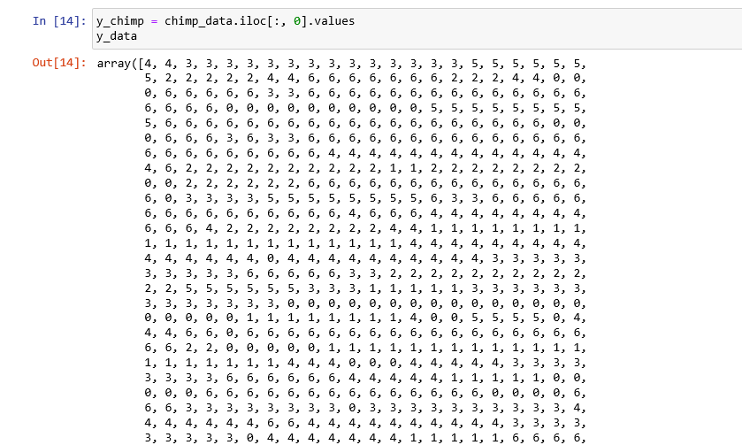

Slide 20
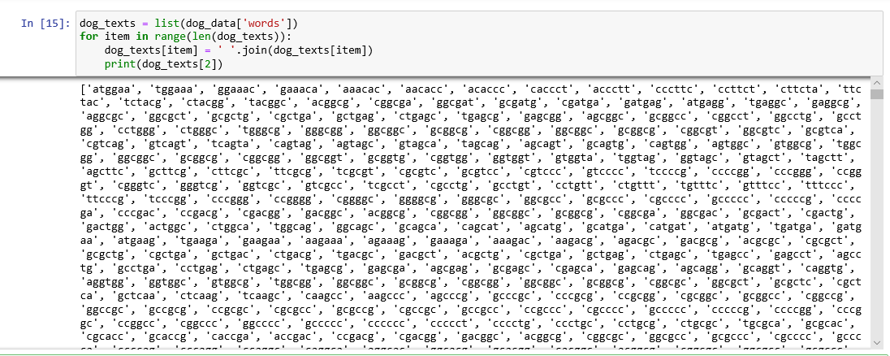

Slide 21
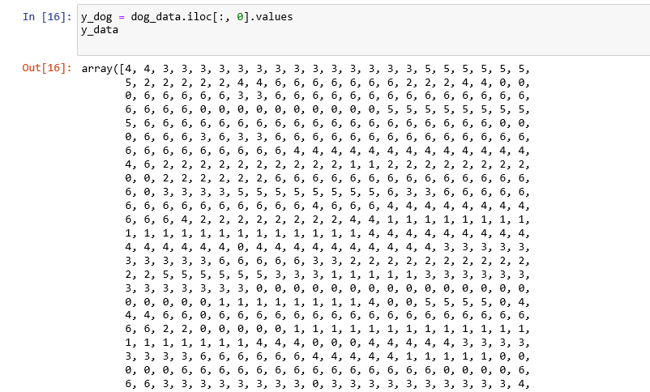

Slide 22
we will apply the BAG of WORDS using CountVectorizer using NLP.
This is equivalent to k-mer counting.

Slide 23
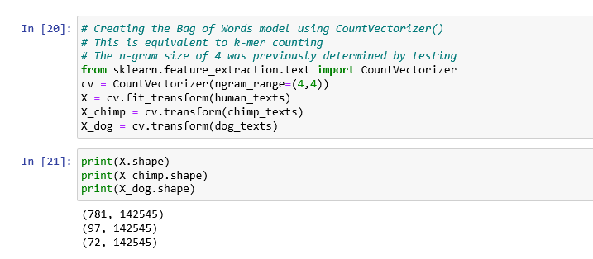

Slide 24
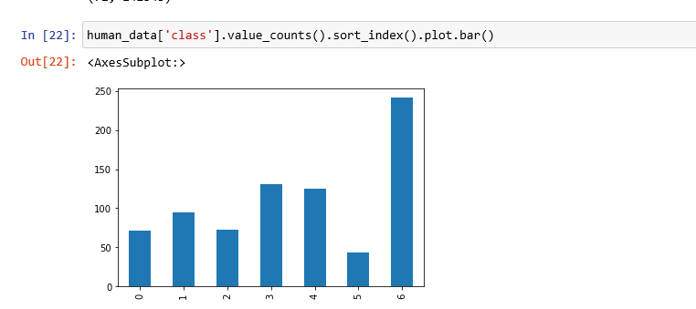

Slide 25
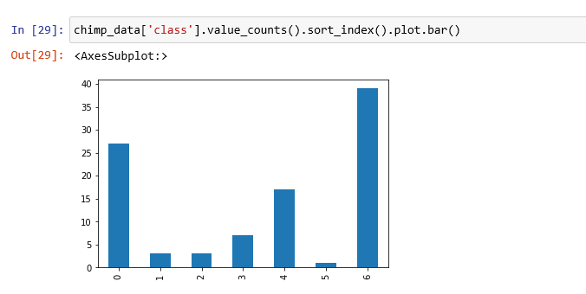

Slide 26
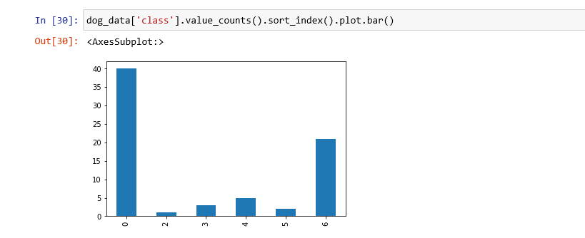

Slide 27
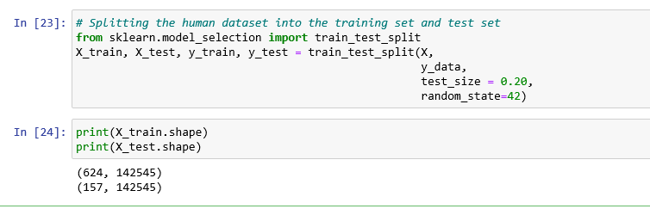
Splitting the human dataset into the training set and test set.

Slide 28
A multinomial naive Bayes classifier will be created. I previously did some parameter tuning and found the ngram size of 4
(reflected in the Countvectorizer() instance)
and a model alpha of 0.1 did the best

Slide 29
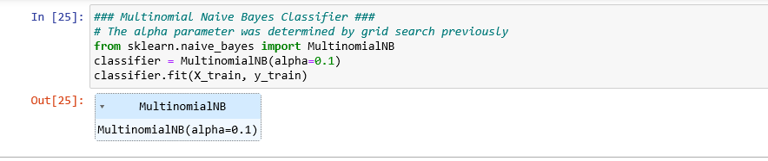

Slide 30
let's look at some model performce metrics like the confusion matrix, accuracy, precision, recall and f1 score. We are getting really good results on our unseen data,

Slide 31
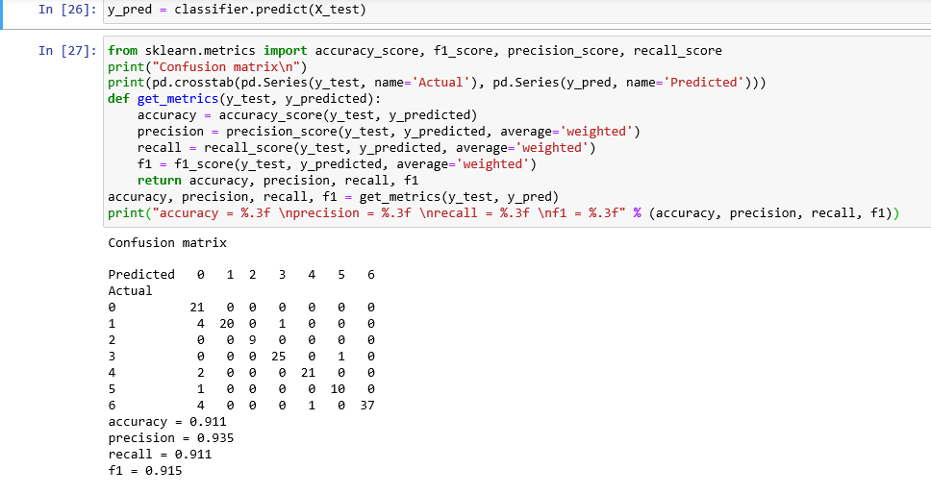

Slide 32
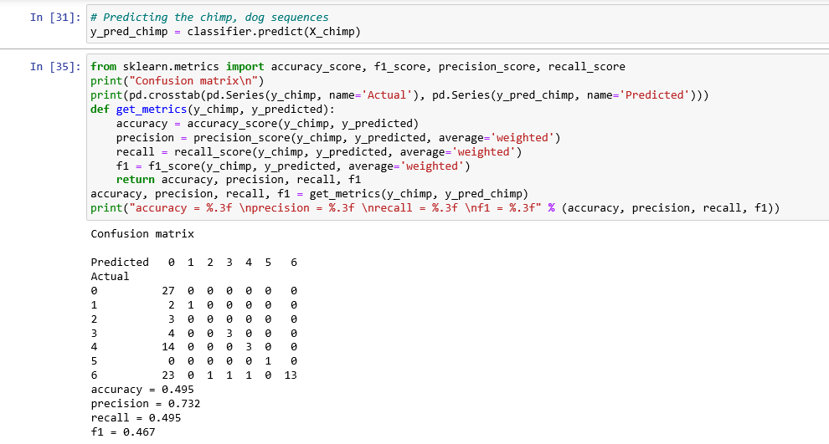

Slide 33
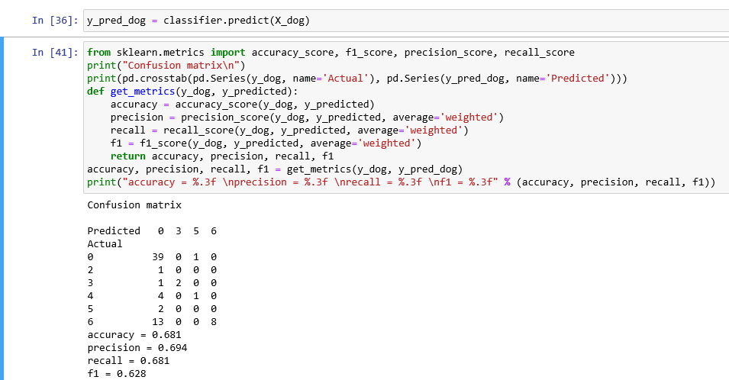

Slide 34
THANK YOU

